Slide 1
Sales force automation
Prepared by:
Sheshdhar mishra

Slide 2
Introduction:
A sales force automation (SFA) tool is a computerized system that provides sales team members with the functionality to track sales leads, manage contacts, control customer
relations, monitor sales processes, schedule meetings, forecast sales and analyze employee performance. Current SFA
tools automate numerous business tasks and assist sales
representatives with information sharing and contact management through a web-based interface.

Slide 3
Purpose :
As the Existing system is completely manual ,to reduce such manual work we have developed this automated system “Sales Force Automation”. SFA is a system that automatically records all the stages in sales process.SFA improves the efficiency and effectiveness of the working of sales department. Sales services allow companies to manage and improve
client relationships. The quality of these services affects
client retention rates and the ability to attract new customers. A company must strive to provide its sales force with the adequate tools to communicate with customers. SFA is software that provides many of the services an
SR uses. These services keep the SR informed about the client.

Slide 4
Scope:
Sales Force Automation (SFA) solution drives sales force performance and profitability by giving you everything you need to sell smarter. By automating your processes, it frees your people to concentrate on creating leads, closing deals and growing your customer relationships

Slide 5
Advantages
Increase productivity: Sales staff can use their time more efficiently and effectively. it can reduce costs, it can increase sales revenue, and it can increase market share hence increase the productivity
Field sales staff can send their information more often.
These systems could increase customer satisfaction

Slide 6
Disadvantages:
Difficulty in adopting the system
Too much of time spent on Data Entry
Cost involved in Sales Force Automation Systems and Maintenance
Difficulty in integration with other management information systems

Slide 7
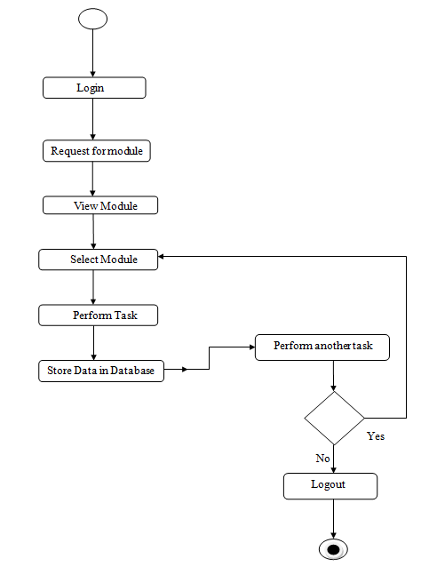
Diagrams: activity diagram

Slide 8
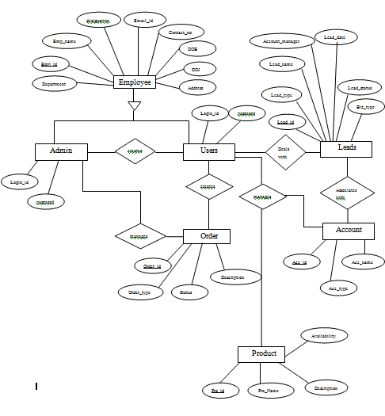
ER diagram:

Slide 9
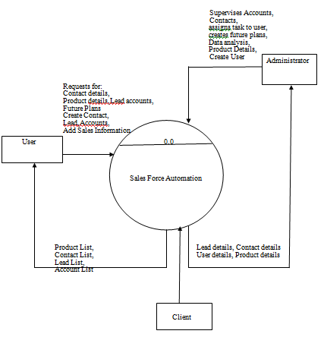
Data flow diagram: context level

Slide 10
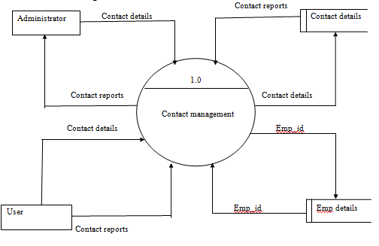
Lavel 1 contact management

Slide 11
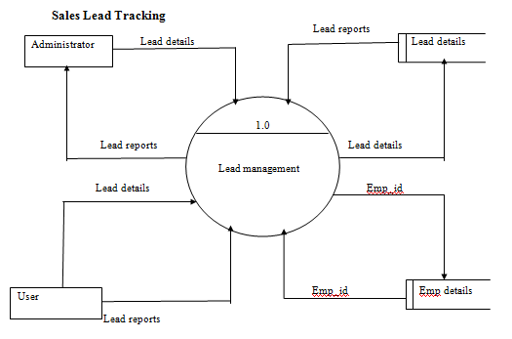
DFD lavel 1: sales lead tracking

Slide 12
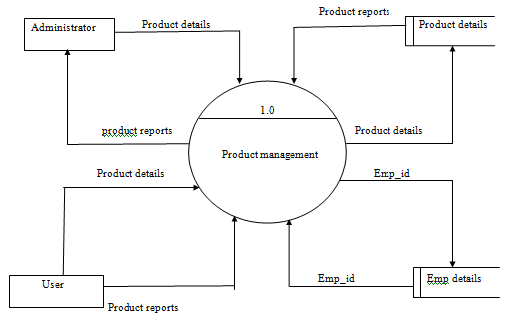
Product management

Slide 13
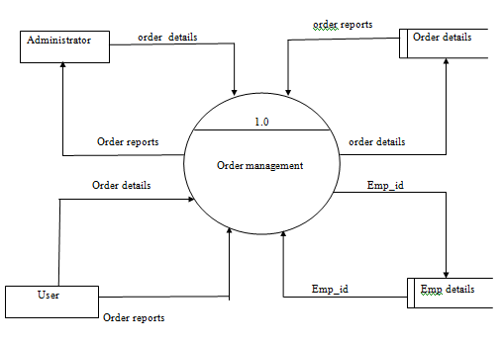
Order management

Slide 14
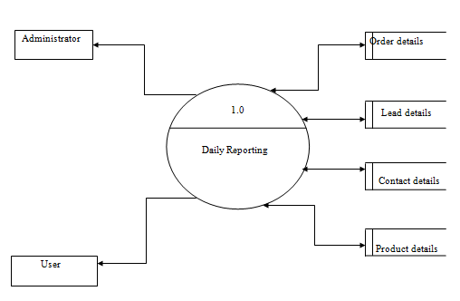
Daily reporting

Slide 15
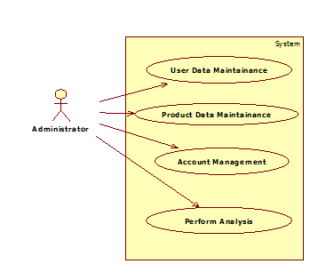
Use case diagrams for administrator

Slide 16
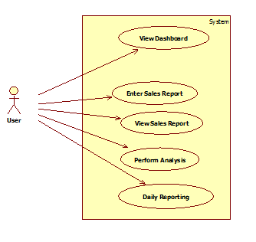
Use Case For user

Slide 17
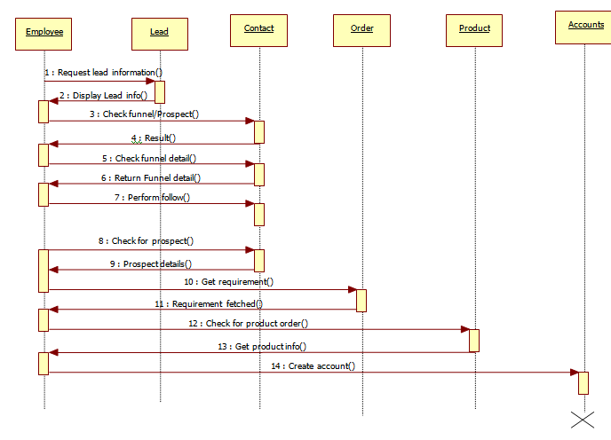
Sequence diagrams

Slide 18
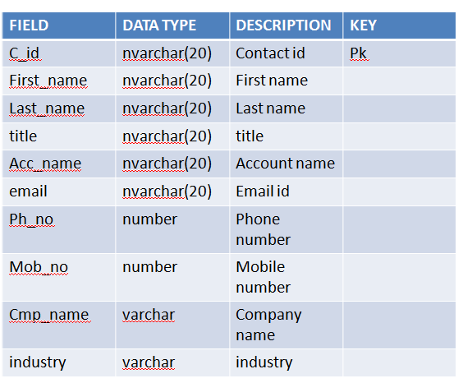
SystemDesign Contact Management

Slide 19
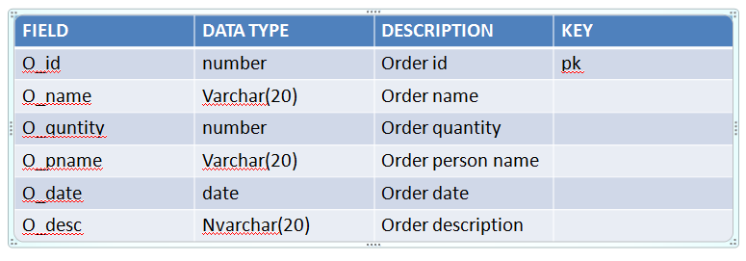
Order Management

Slide 20
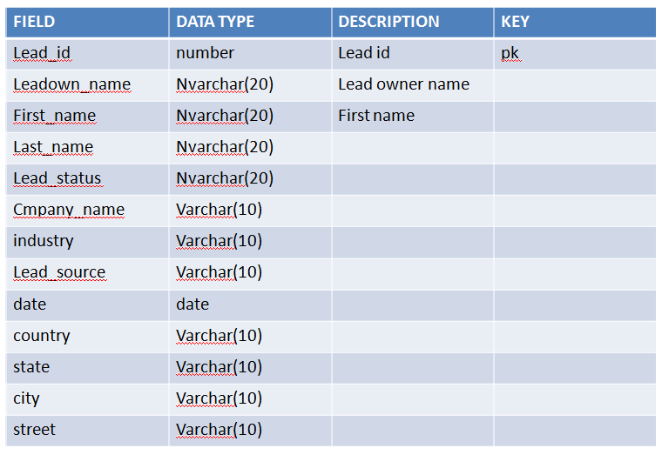
Lead Table

Slide 21
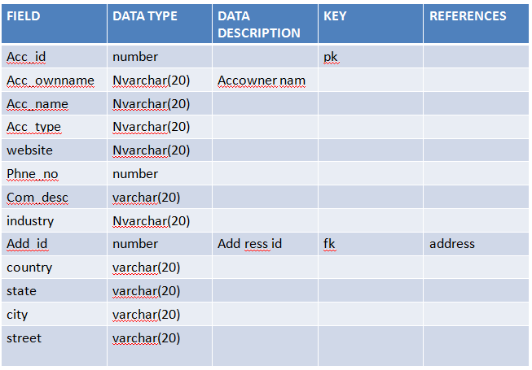
Account Table

Slide 22
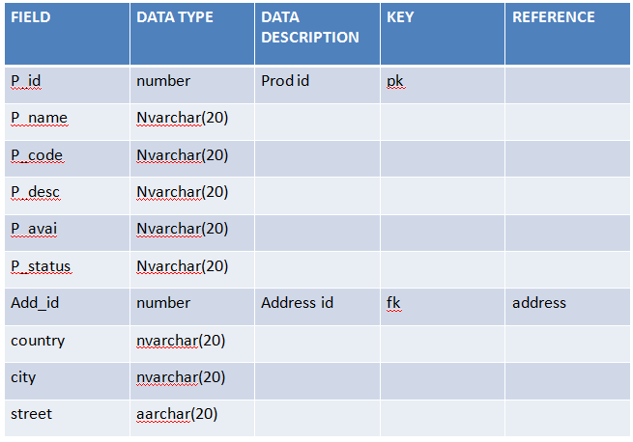
Product Table

Slide 23
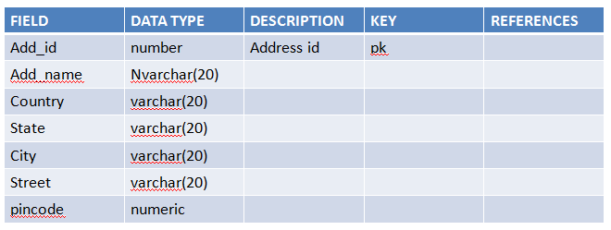
Address Table

Slide 24
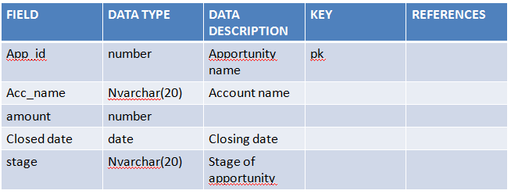
Apportunity Table

Slide 25
Thank You

